Slide 1

ELEVATE YOUR ASCENT.
Pinnacle Paths: The Premier Trail Discovery & Management Platform.

Slide 2
The Team
Aryan Jain
Arihant Singh
Team Leader
Research Analyst & API
Anush Sharma
Anupam Mishra
Presentation & Strategy
UI & UX Designer

Slide 3

The Problem
Where can young, modern hikers find a single, reliable hub to discover curated trails and essential planning resources?
How can a centralized platform make outdoor adventure planning seamless, safe, and accessible for the next generation?

Slide 4
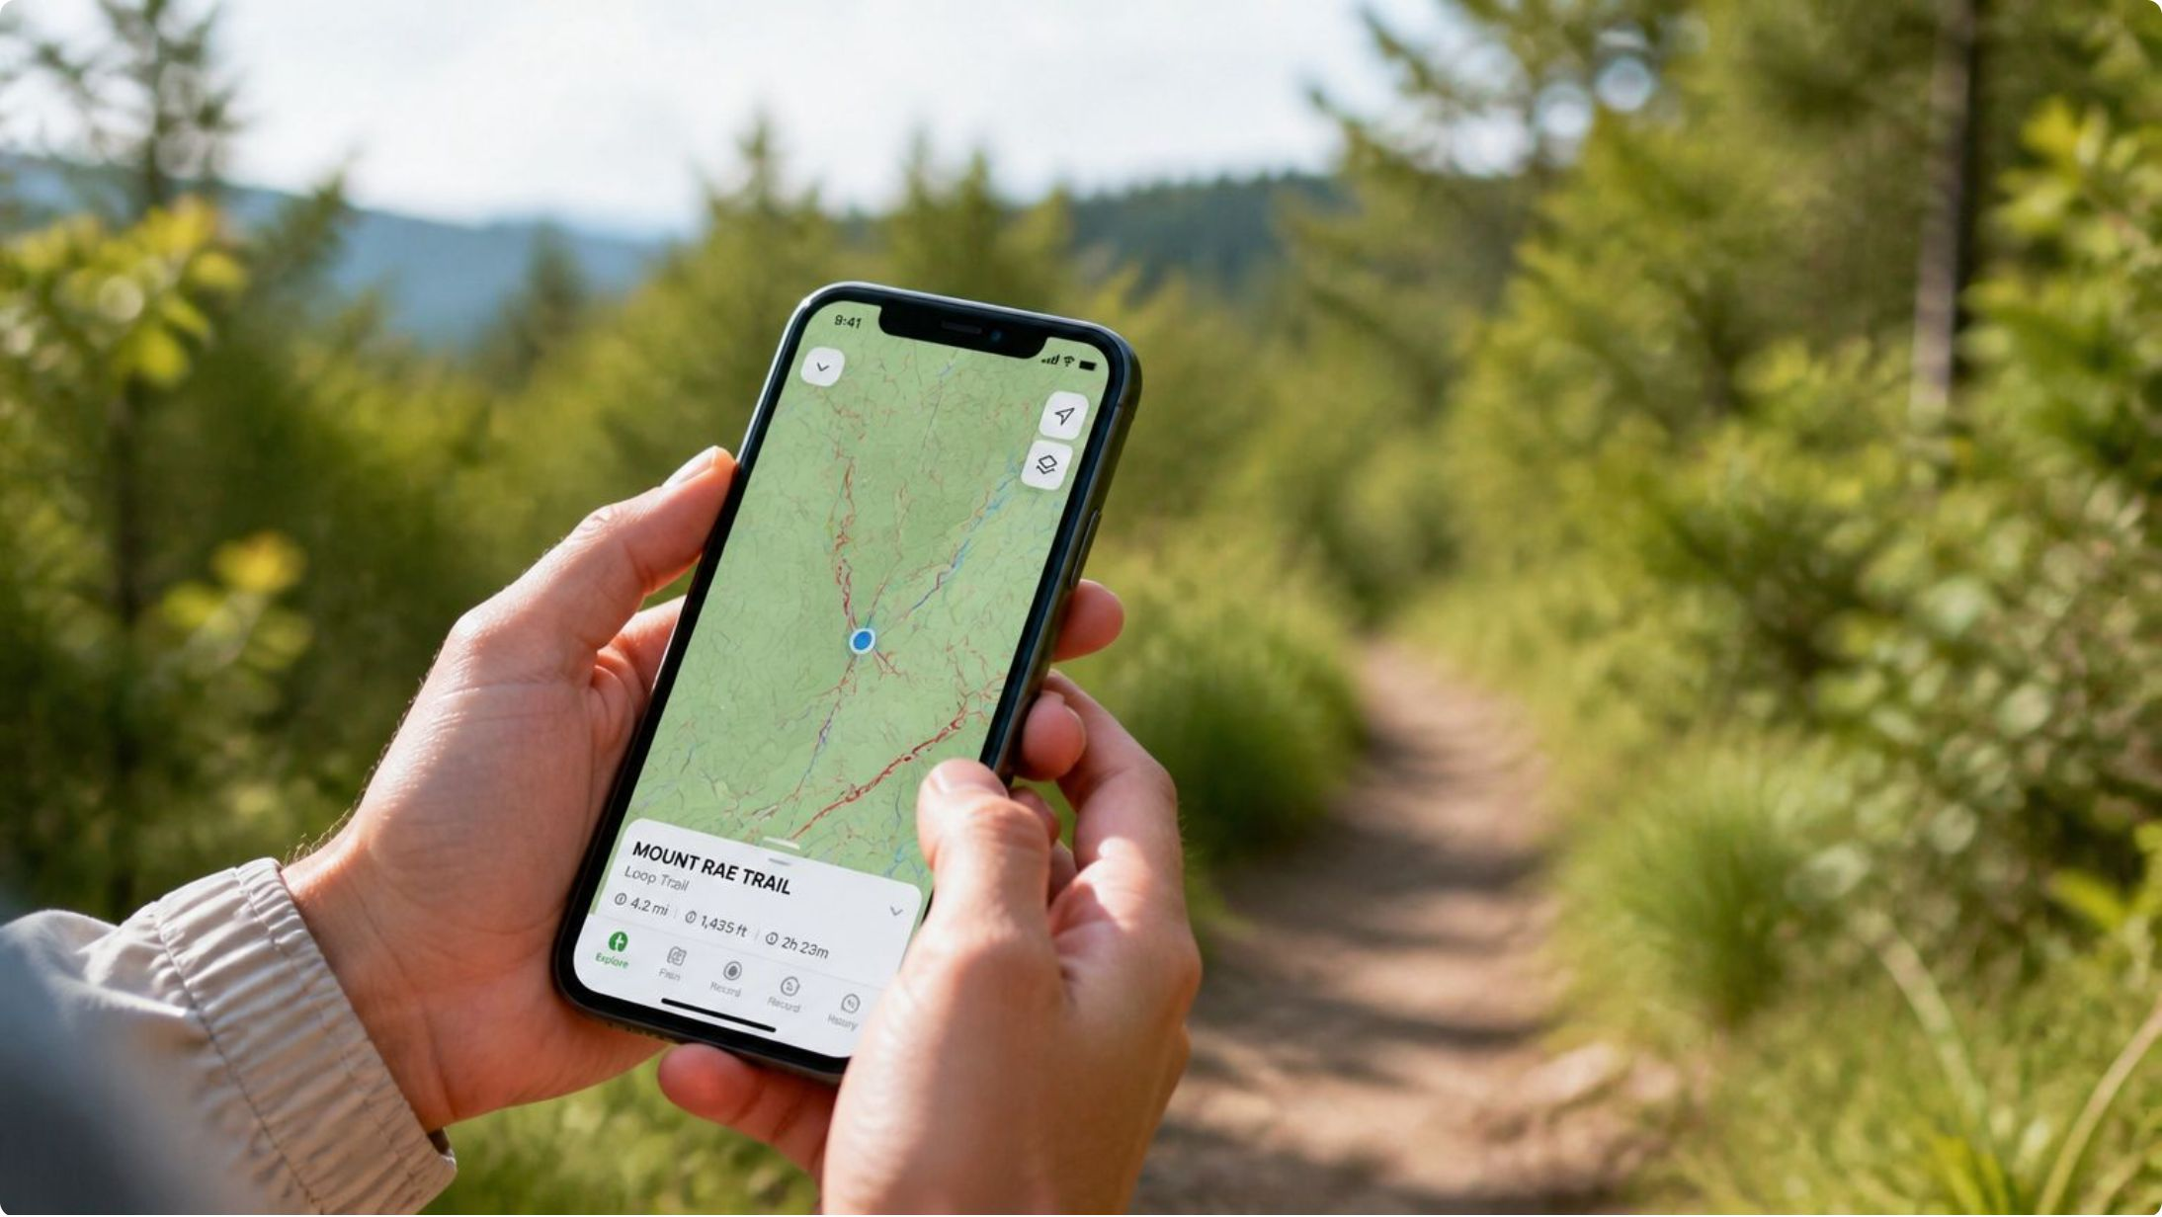
The Solution
A specialized webapp can aggregate crowd-sourced real-time trail updates, interactive offline maps, and verified difficulty ratings tailored specifically for Gen Z travelers.
Eco-Conscious Tips
Plan sustainable treks that protect natural environments.
Community Forums
Offline Maps
Connect with fellow adventurers for real-time trail insights.
Navigate confidently without cellular connectivity.

Slide 5




Standardized Difficulty Framework
TIER 1: LEISURE
TIER 2: MODERATE
Well-maintained, minimal elevation paths. Optimal for casual recreation, family outings, and low-impact activity.
Steady inclines and uneven terrain. Requires baseline cardiovascular fitness and purpose-built footwear.
TIER 3: ADVANCED
TIER 4: EXTREME
Aggressive elevation profiles and rock scrambling. Demands high endurance and navigational competence.
Technical alpine environments. Strictly mandates specialized equipment and advanced wilderness survival training.

Slide 6

Data-Driven Itinerary Generation
Computational Precision
Pinnacle Paths replaces manual searching with computational precision. Our proprietary algorithm evaluates user fitness metrics, time constraints, and terrain preferences.
By cross-referencing thousands of topological data points, the system instantly generates an optimized, personalized hiking itinerary that aligns perfectly with user parameters.
Cross-Reference Data
Analyze thousands of topological points
Generate Itinerary
Input Metrics
Personalized, precision-matched route
Fitness, time, terrain prefs

Slide 7




Uncompromised Safety Infrastructure
True Offline Topography
Micro-Climate Forecasting
High-fidelity maps pre-download to the device. Geo-positioning maintained exclusively via satellite uplink — fully independent of cellular networks.
Preemptive alerts for localized atmospheric shifts based on user elevation. Because rapidly changing mountain weather poses severe, life-threatening risks.
Verified Condition Reports
Real-time, crowdsourced intelligence from verified users who traversed the route within the past 24 hours, mitigating unforeseen environmental hazards.

Slide 8

Our Vision
We believe the wilderness should be accessible through accurate, reliable information.
Pinnacle Paths is committed to democratizing exploration by engineering the safest, most intelligent digital tools for the outdoor sector. The future of adventure belongs to those with the best information.

Slide 9


Performance Analytics & Milestones
Quantifiable Achievements
Pinnacle Paths transforms physical exertion into trackable, measurable data. The application meticulously logs aggregate vertical ascent, distance traversed, and specific routes completed.
Vertical Ascent Logging
Verified Digital Milestones
Long-Term Engagement
Track cumulative elevation gain across every session.
Earn badges for significant accomplishments and build a verified outdoor portfolio.
Gamified progress fosters consistent return and community recognition.

Slide 10

Enterprise-Grade Architecture
1
2
3
Frontend Framework
Cloud Infrastructure
Cryptographic Security
Built on React Native — a robust cross-platform framework delivering a responsive, latency-free experience across both iOS and Android ecosystems.
Integrated with highly scalable cloud databases capable of serving heavy topological data with 99.9% uptime.
End-to-end encryption for all user telemetry and location data, adhering to the highest standards of data privacy.

Slide 11
Research Papers
RESEARCH PAPER | AUTHORS | PUBLISHED | KEY FINDINGS (RELATIVE TO PINNACLE PATHS)
Gamification of Walking in Nature: A Field Experiment with Pokémon GO Routes | Samuli Laato, Sampsa Rauti, Bastian Kordyaka, Konstantinos Papangelis, Sangwon Jung, Timo Nummenmaa, Juho Hamari | October 18, 2024 | Gamified map-based apps can encourage nature exploration. Rewards, proximity, and scenery influence route popularity—supporting engaging trail discovery.
Urban Physical Environments Promoting Active Leisure Travel: An Empirical Study Using Crowdsourced GPS Tracks and Geographic Big Data from Multiple Sources | MDPI | April 28, 2024 | Crowdsourced GPS data shows how environmental factors influence walking, cycling, and running routes—supporting data-driven trail recommendations.
A Trail-Based Approach Using Crowdsourced Data to Assess Recreationists' Preferences for Landscape | Chai-allah et al. | 2023 | Crowdsourced outdoor platforms help identify recreation preferences. Scenery, enjoyment, landscape, and physical effort shape outdoor experiences.
GPS Navigation on Trails: A Hiker's Practical Guide | Peaks of the Balkans | June 09, 2026 | Reliable navigation, offline maps, GPS accuracy, and backup methods are important where cellular coverage is limited—supporting offline navigation.

Slide 12

EMBARK ON YOUR NEXT JOURNEY.
Strategic planning for the modern explorer.
Website
www.pinnaclepaths.com
Partnerships
partnerships@pinnaclepaths.com

